Slide 1
Learning Objective
The spatial and temporal distribution of bushfires and how an understanding of biophysical and human processes can be used to explain the patterns that are identified.

Slide 2
What does Spatial Distribution mean?
Spatial distribution
The arrangement of particular phenomena or activities across the surface of the Earth.
The spatial distribution of bushfires can be seen by satellite imagery among the drier climates of the planet, such as Mediterranean and semi-arid regions. There is a strong association between the sub-tropical latitudes where climates have hotter and drier summers and the occurrence of bushfires.
These areas have a number of factors that make them susceptible:
- hot, dry summers with low humidity
- abundance of native flora which is combustible
- they experience summer lightning storms and strong winds
- mountainous topography

Slide 3
What does Temporal Distribution mean?
Temporal distribution
The occurrence and frequency of particular phenomena or activities across the surface of the Earth.
Temporal distribution relates to the distribution of bushfires over a period of time.
There is a close association between bushfire events and the seasons.
Bushfire season in Australia lasts from December until April.
There is a higher incident of fires occurring during this time.
Climate change is affecting TEMPORAL DISTRIBUTION.
Extreme fires burn 100,000 + hectares. 100 years ago these events used to occur every 15 years, in the future they are predicted to occur every 1 and 5 years.

Slide 4
What biophysical factors/processes affect the distribution of bushfires in Australia?
Bushfires are considered atmospheric hazards.
.
The Indian Ocean Dipole and the El Nino and La Nina climate processes influence the variability of Australia’s climate and rainfall patterns.
They can increase the vulnerability of Australia to bushfires.
Australian flora – has adapted to the dry climate of Australia with eucalypts and drought resistant plants and shrubs becoming endemic to the Australian bush.
Eucalypt forest is distributed along the coastal strip of Eastern, Southern and Western Australia.
Many species of Eucalypts contain a high ratio of oil and shed leaves and bark at a frequent rate.
This results in a build up of leaf litter in the forests and provides fuel for fires.

Slide 5
What Human processes affect the distribution of bushfires in Australia?
Human induced climate change has been associated with growing trends and the increased frequency of heatwaves and the reduction of precipitation.
This increases the risks and vulnerability of communities to bushfires.
Increase in Urban Sprawl into the rural-urban fringe brings increased potential for damage to property and lives.
Land clearing for human uses, such as agriculture, impacts on the rates of evapotranspiration, which in turn leads to a disruption of the water cycle, at a local level reducing the amount of precipitation.

Slide 6
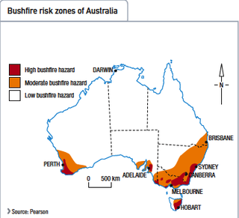
Bushfires are notably common in South Eastern Australia, particularly in Victoria.
The hot and dry climate of Australia's summer is prime for the birth of a bushfire.
As shown in the diagram on the left, bushfires are most susceptible to occur on the east coast of Australia, particularly in the Great Dividing Range, where huge areas of bushland are present.
While spots of Victoria are also dubbed with a high risk of bushfires.
In Tasmania, The entire east half of Tasmania is susceptible to the hazard, ranging from a moderate risk to a high risk.
In South Australia, the region of Adelaide has a high bushfire risk as well as the South West of Australia.

Slide 7
As for the rest of Australia (Darwin, Most of Queensland and Most of Western Australia) do not have a large or moderate risk of bushfires occurring, they simply have a low possibility of it occurring.
This is mainly because their simply isn't any bushland or "fuel" for it to occur.

Slide 8
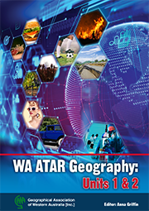
3.4 Measuring Bushfires
Read pages 68 – 70. You will complete the following activities in your notes.
Be mindful of the key directional word. Use this to frame your response and the amount of detail you should include.

Slide 9
Complete the following questions:
1. State how bushfires are categorised.
2. State what Fire Intensity refers to.
3 State what BAL stands for.
4. State what factor determines the intensity of a fire.
5. Describe how Fire Intensity can be measured and calculated.
6. Outline the association between fuel types and the intensity of future bushfires.
7. State what FDR stands for. Outline what the FDR is based on.
8. State what GFDI stands for.
9. State what FFDI stands for and list the considerations this index takes into account.
10. List the 3 levels of levels of response as outlined by the State Emergency Management Plan.
11. Describe what Fire Intensity refers to.
12. List the levels in the National Fire Danger Rating System. ‘
13. Define duration and how this relates to bushfires, using examples.
14. Define, frequency, probability and scale in the bushfire context.

